Slide 1

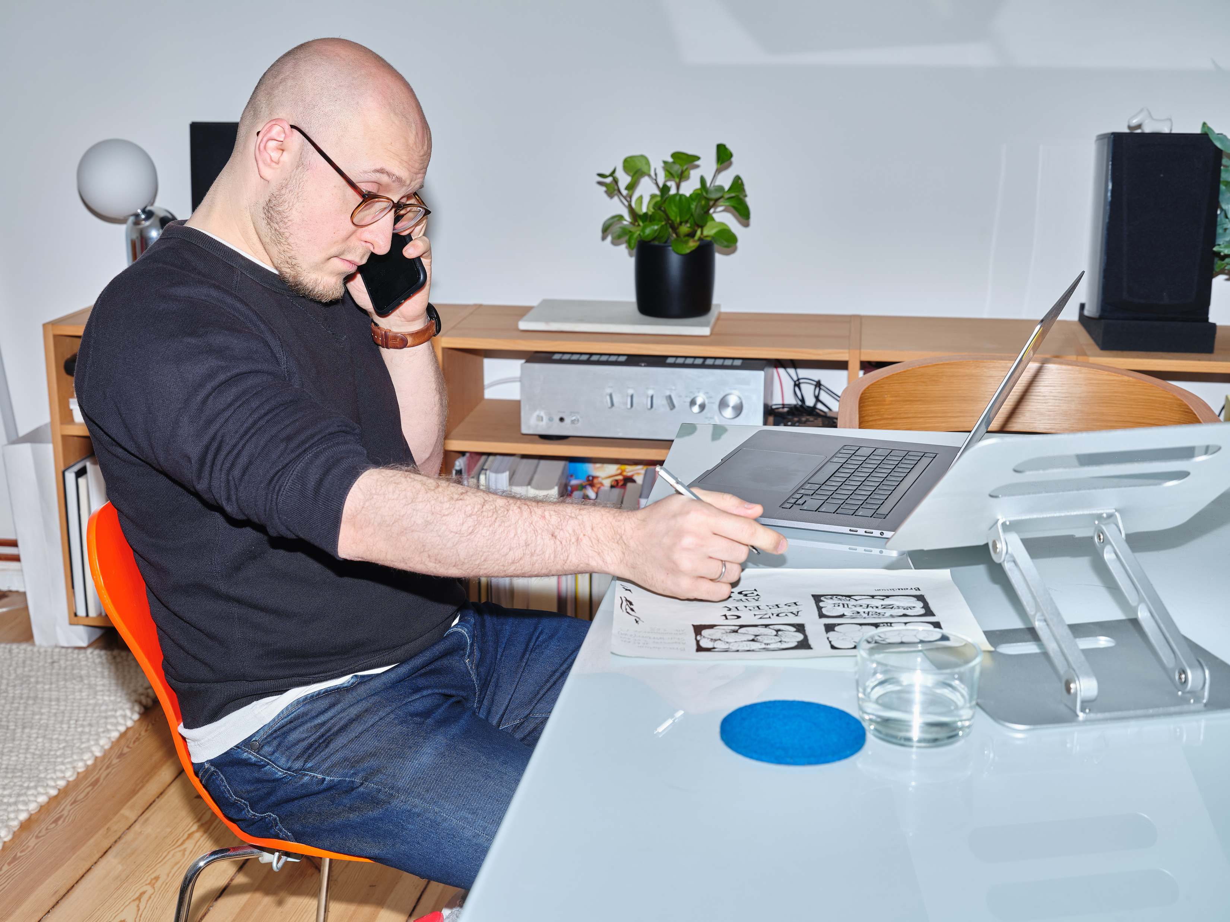



My Portfolio
Creative Graphic Designer specializing in impactful visuals and branding.
Presented By:
Estelle Darcy
www.reallygreatsite.com

Slide 2
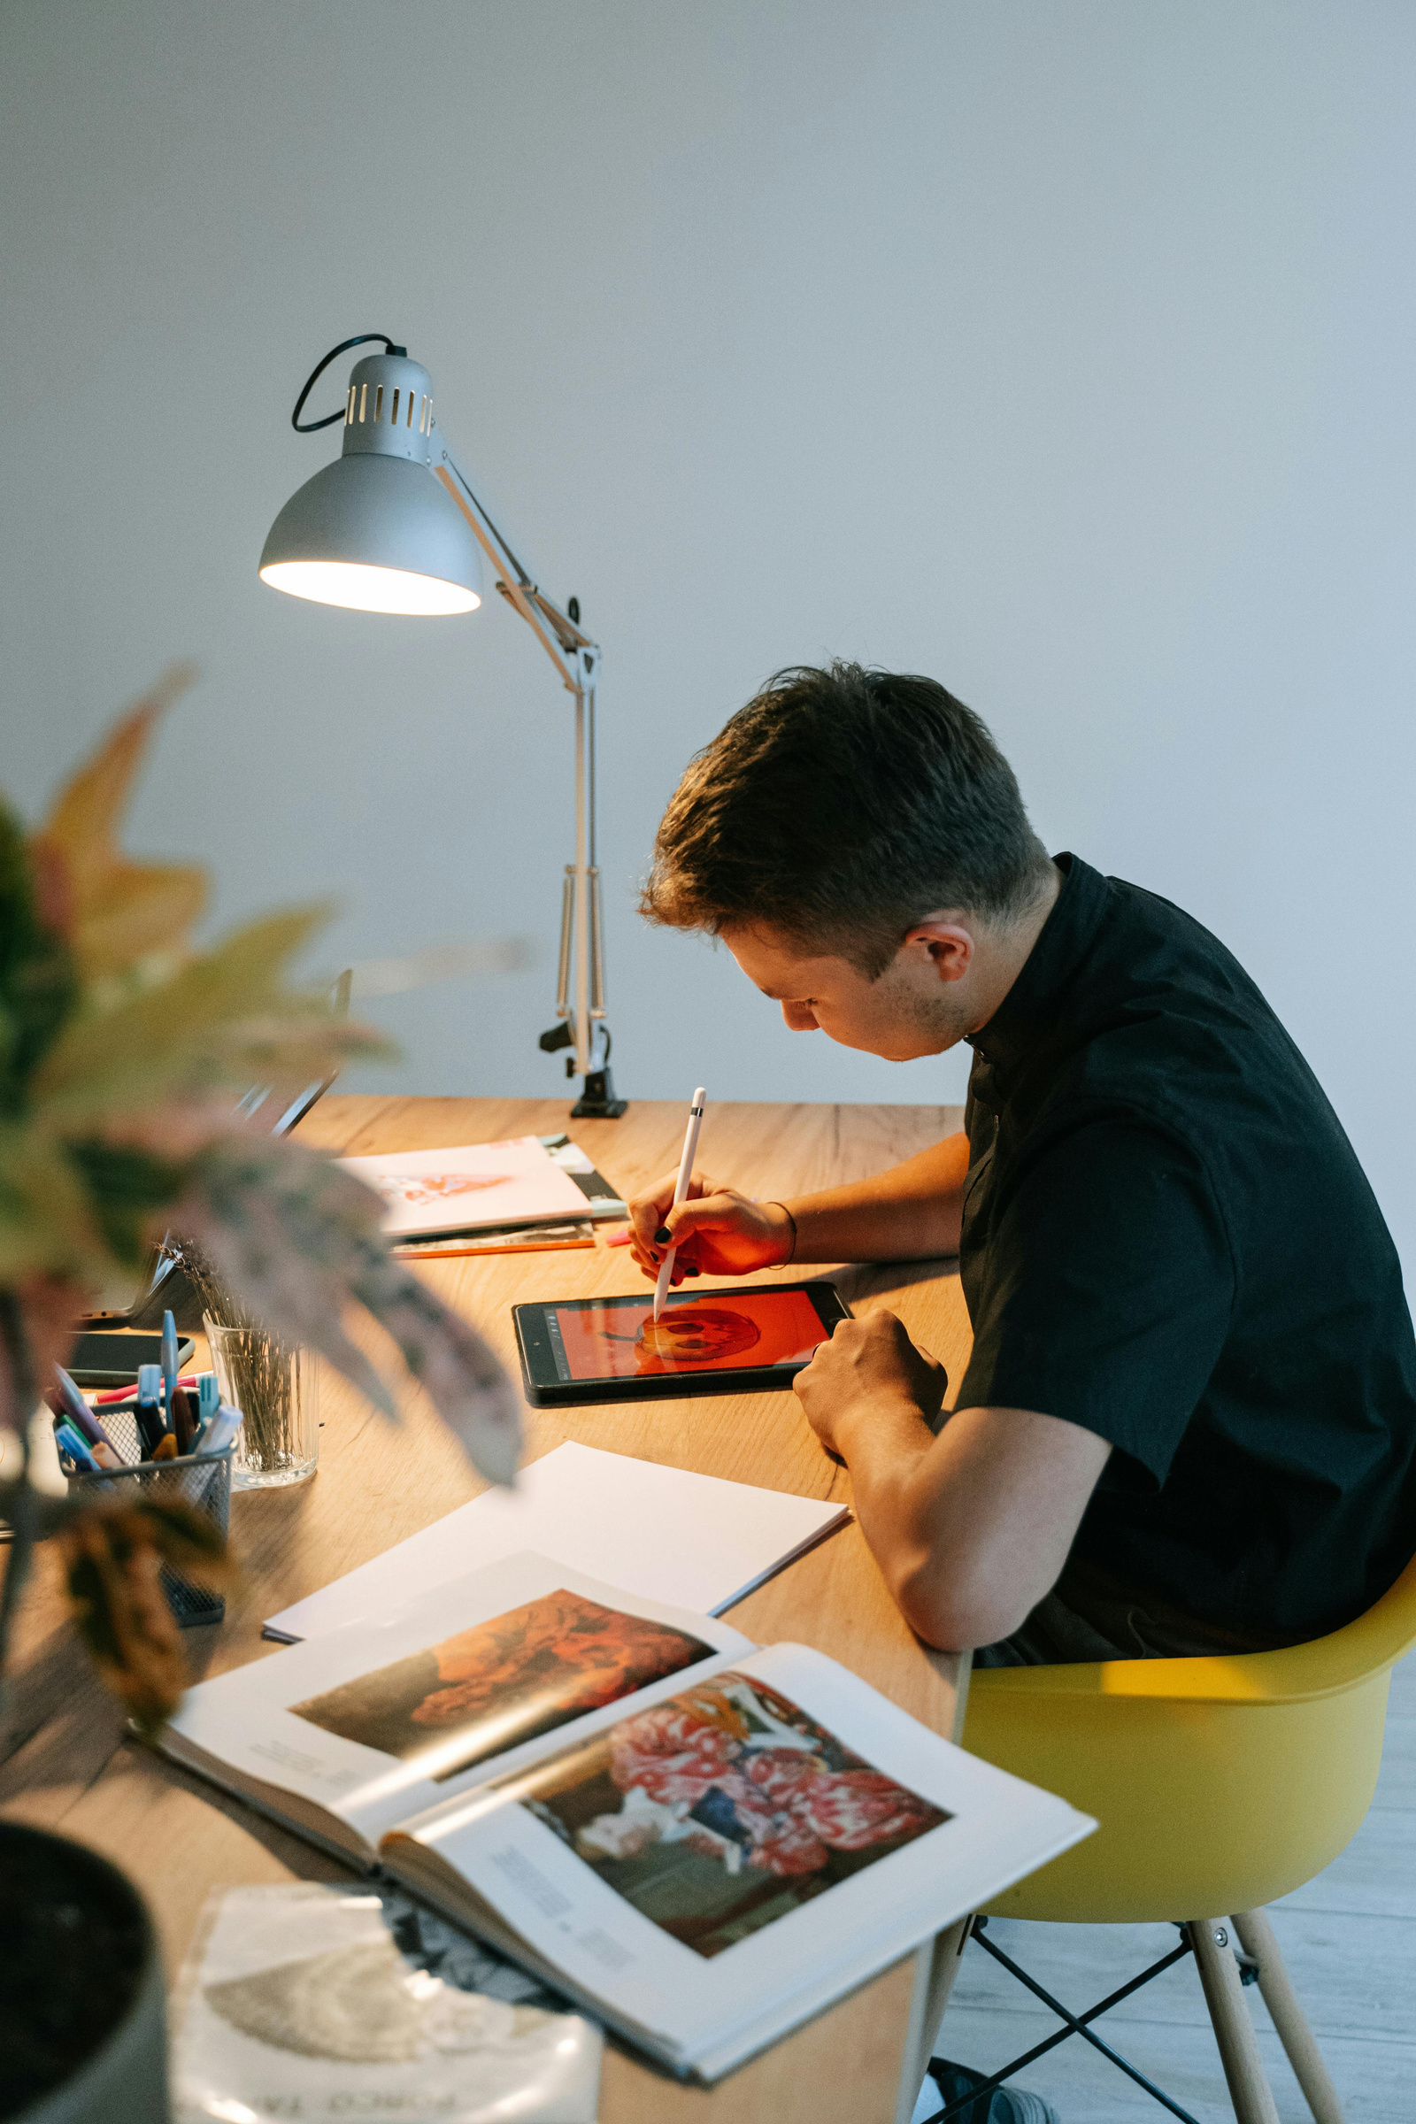

Hello!
Welcome to my portfolio! I’m Estelle Darcy, a creative and passionate graphic designer specializing in branding, visual storytelling, and digital design. Explore my journey and discover projects that highlight my creativity and design expertise.

Slide 3
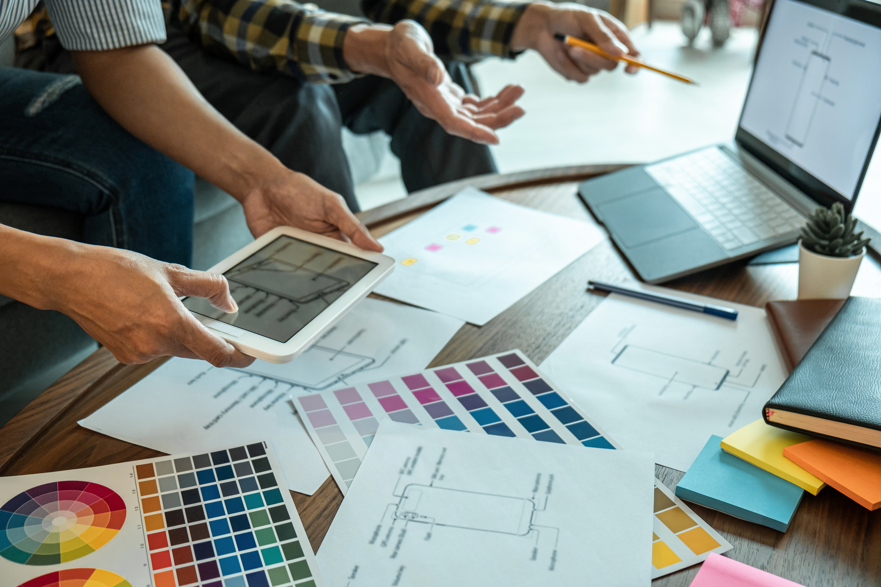
Bachelor of Arts in Graphic Design – University B, 2018
Education Background
Focus on Visual Communication, Typography, Branding, and User Interface Design
Graduated with Honors

Slide 4
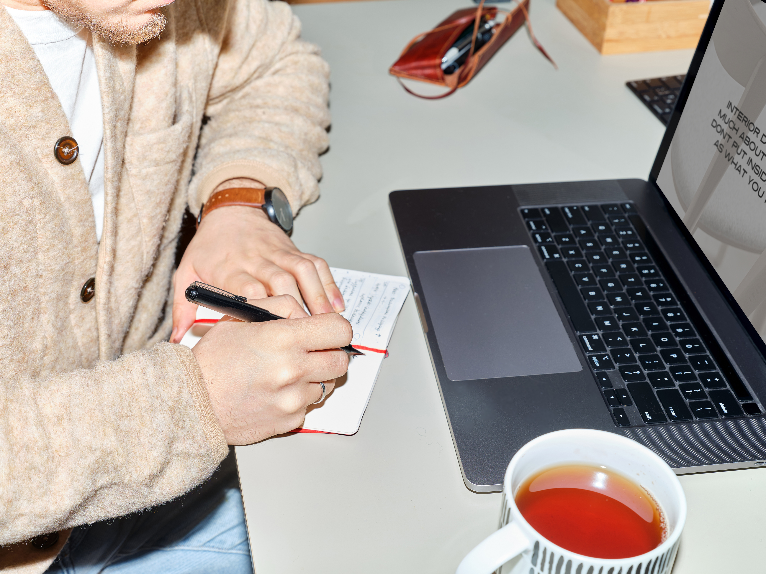
Personal Skills
Branding
UI/UX Design
Illustration
Typography
Skilled in creating unique and recognizable brand identities.
Experienced in designing user interfaces and enhancing user experience.
Proficient in creating hand-drawn and digital illustrations.
Expertise in selecting and creating visually appealing fonts and layouts.

Slide 5
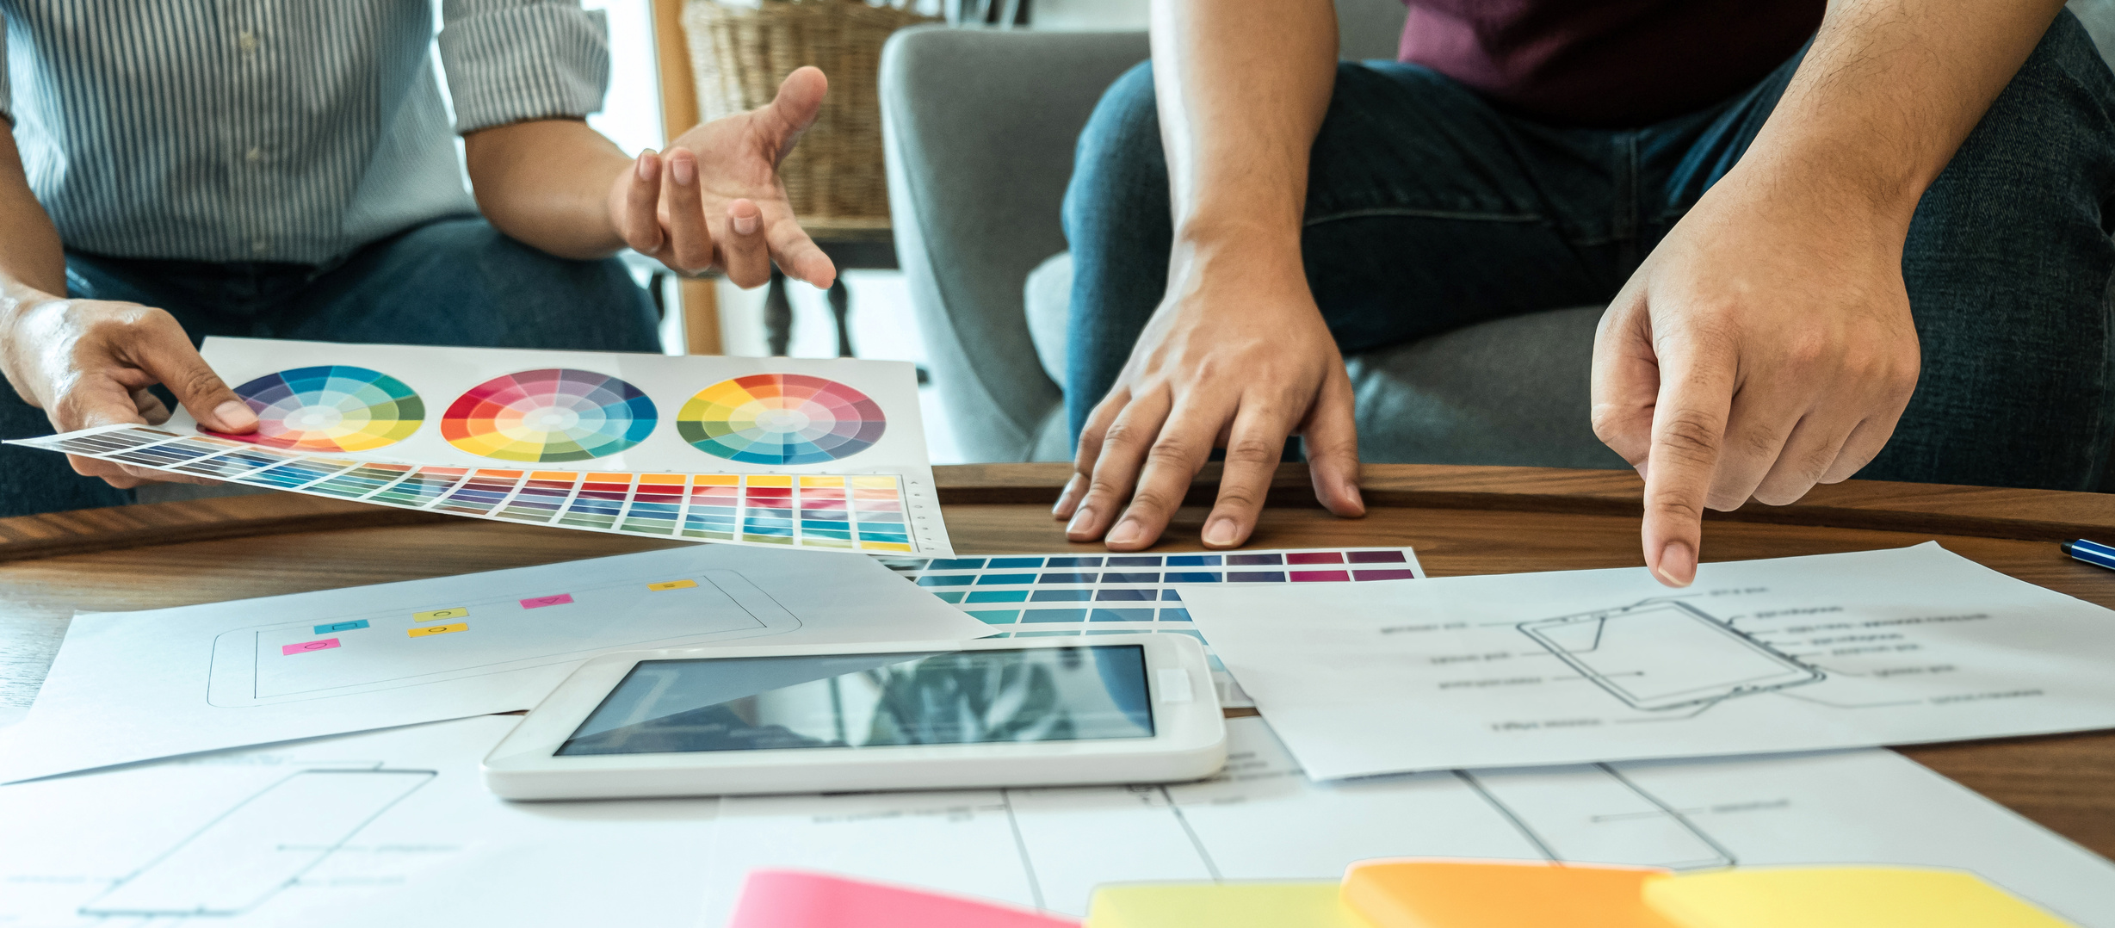
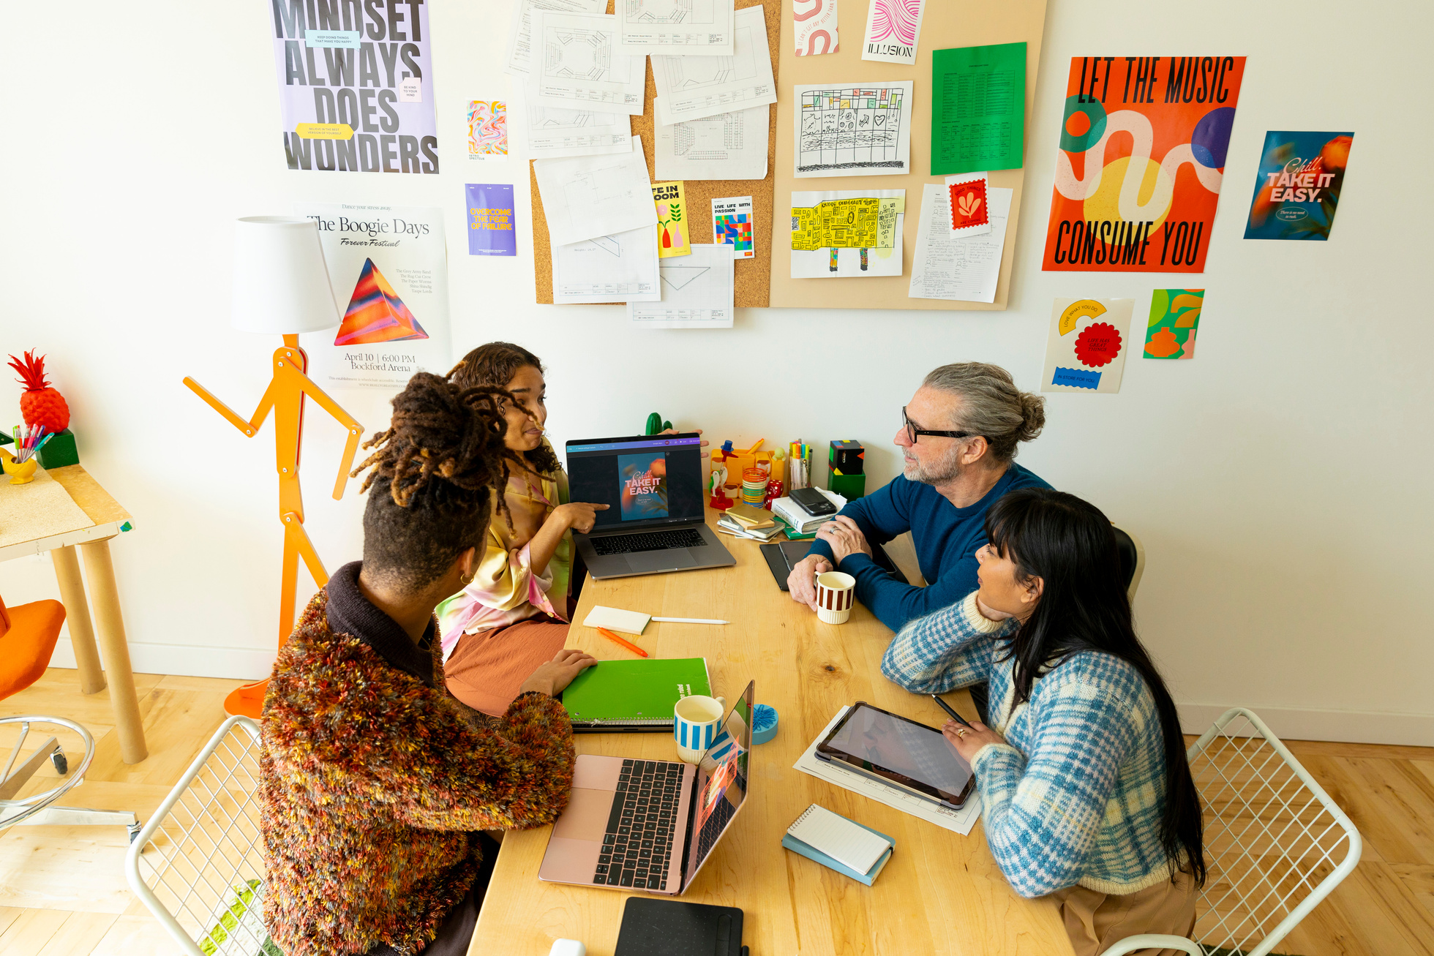

Work Experience
Graphic Designer – Giggling Platypus Co. –(2020–Present)
Designed branding, websites, and promotional materials for clients across diverse industries.
Junior Graphic Designer – Wardiere Inc. (2018–2020)
Assisted in creating marketing materials, web assets, and social media visuals.

Slide 6
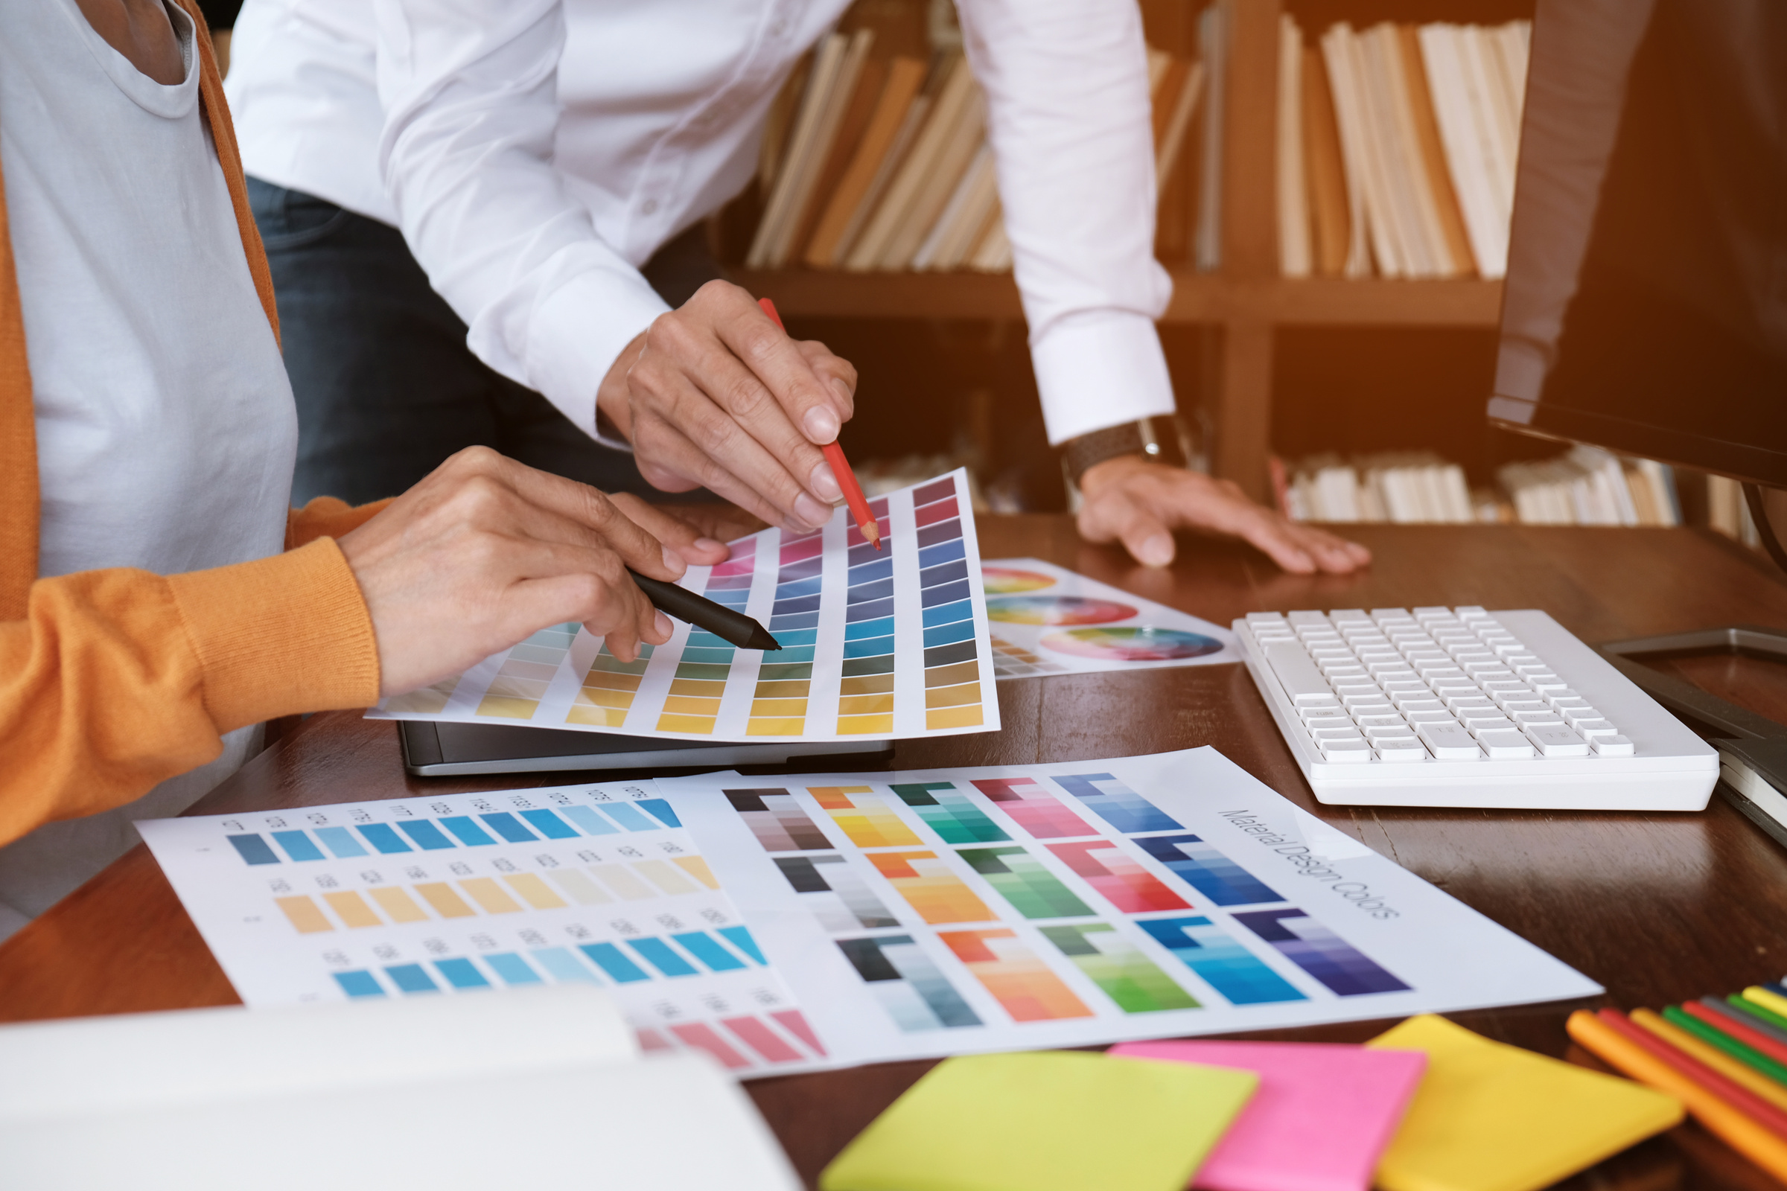

Project Portfolio
Project 1
Project 2
Project 3
Branding Design for E-Commerce Business
Website Redesign for Smoothie Cafe
Social Media Campaign Design

Slide 7
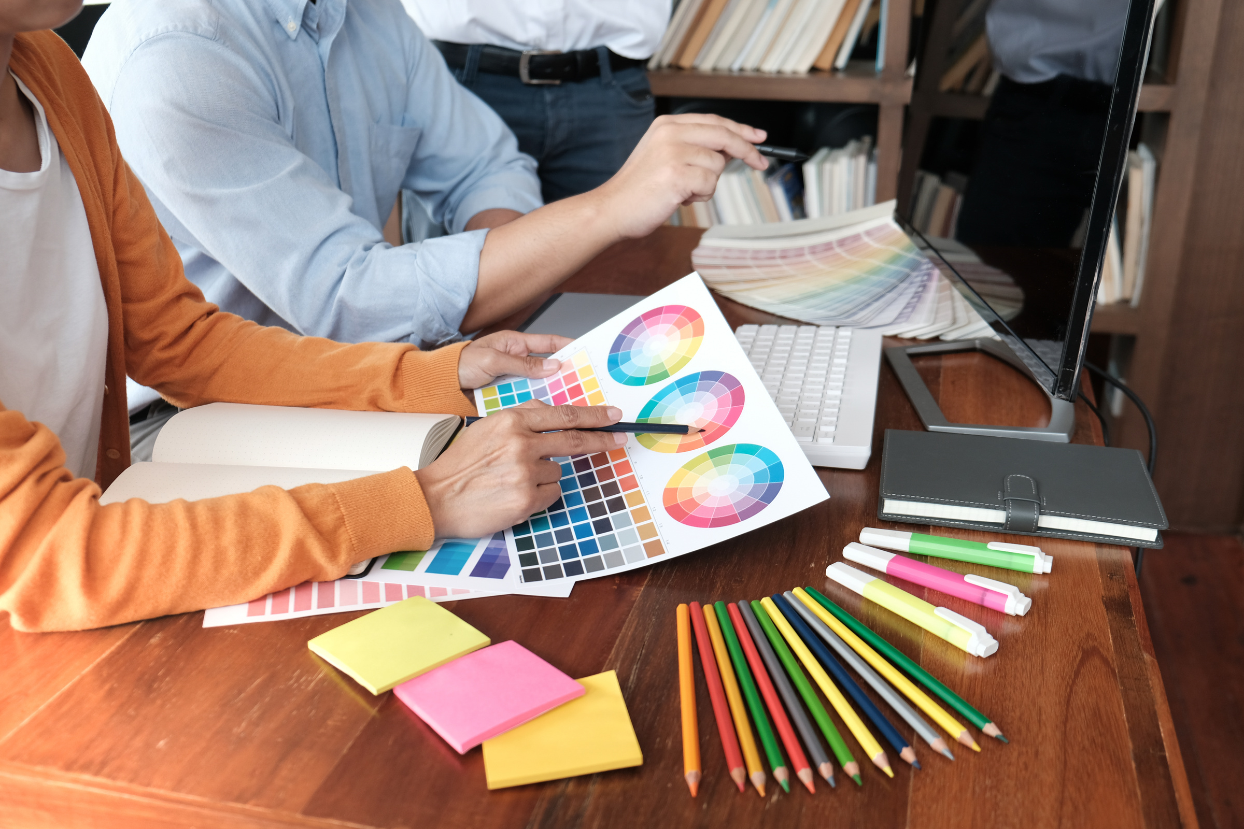
Project 1
“Revamp Your Brand”
Branding Design for E-Commerce Business
Led an e-commerce rebrand with a new logo, color palette, and typography, creating a modern, approachable look to appeal to younger audiences.
The redesign boosted user engagement and brand awareness by 30%.

Slide 8
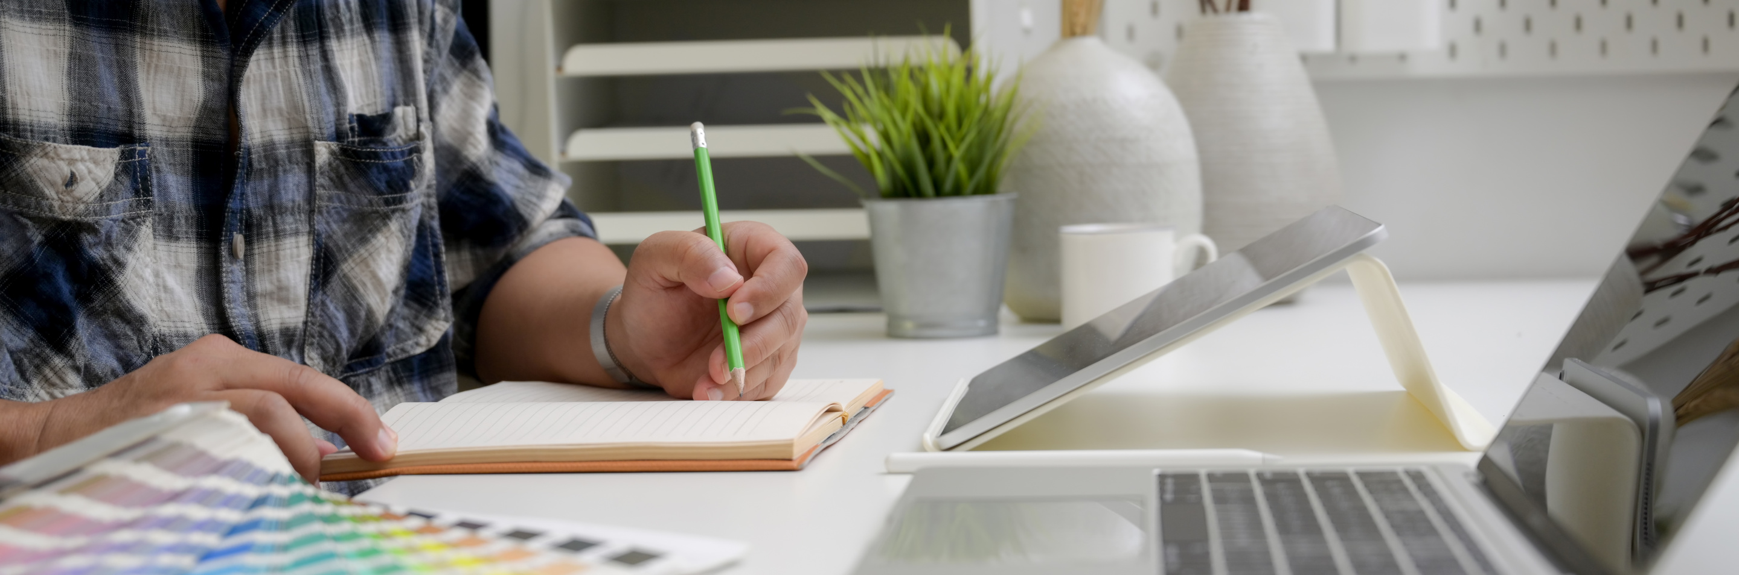
“SmoothFlow”
Website Redesign for Smoothie Cafe
Redesigned the café’s website with a clean, modern, and user-friendly layout, enhancing usability and creating visually appealing landing pages.
Project 2
The new site saw a 20% increase in online orders within the first month.

Slide 9
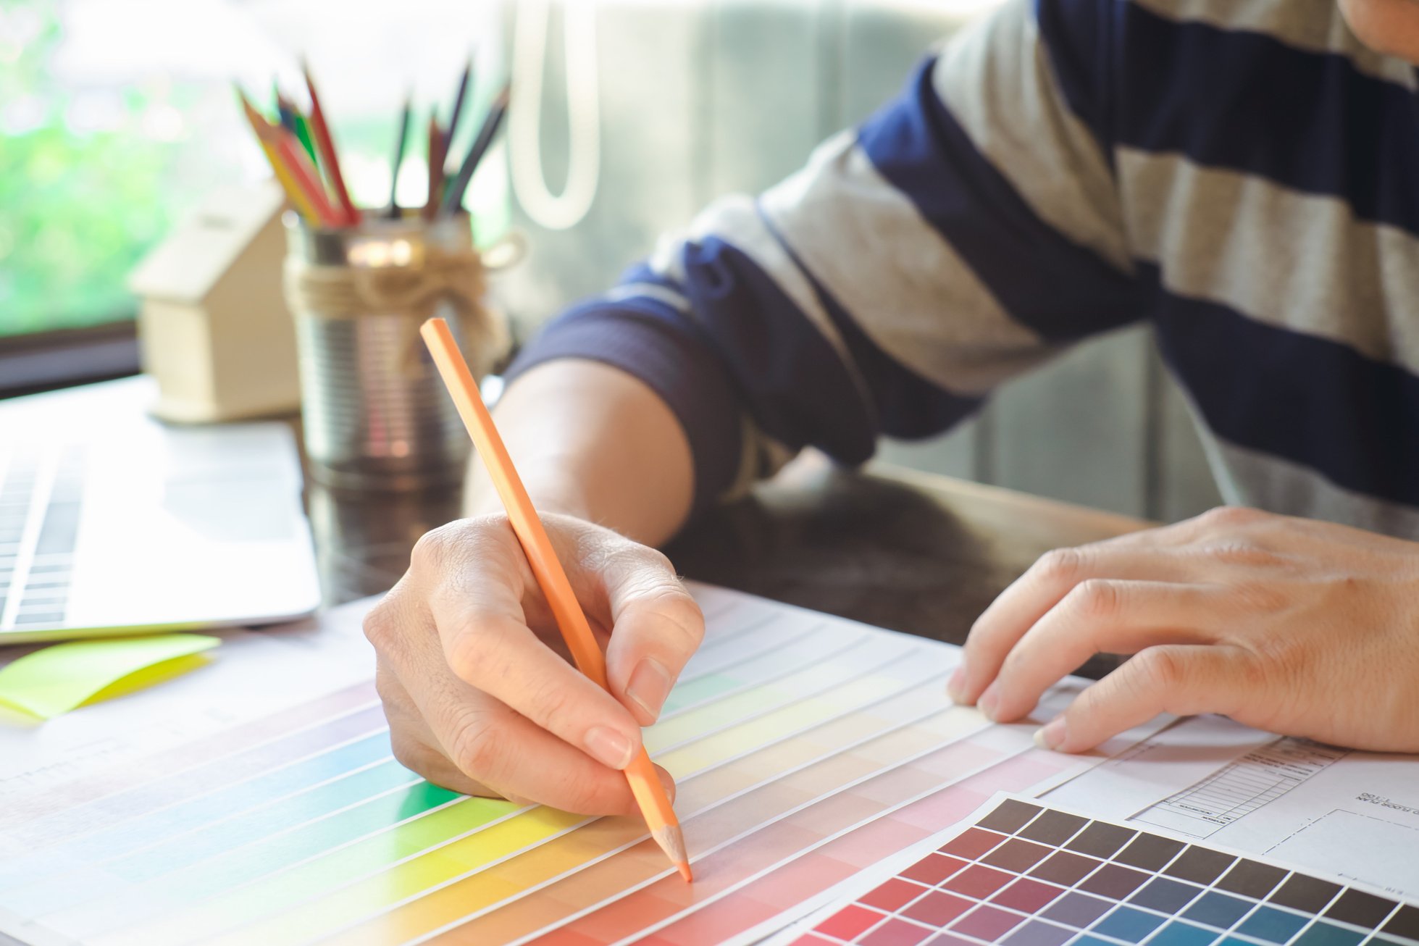
Project 3
“Social Spark”
Social Media Campaign Design
Created engaging and creative graphics for a social media campaign aimed at increasing brand visibility for a tech startup.
The campaign generated over 50.000 social media impressions and gained 1.000 new followers within two weeks.

Slide 10
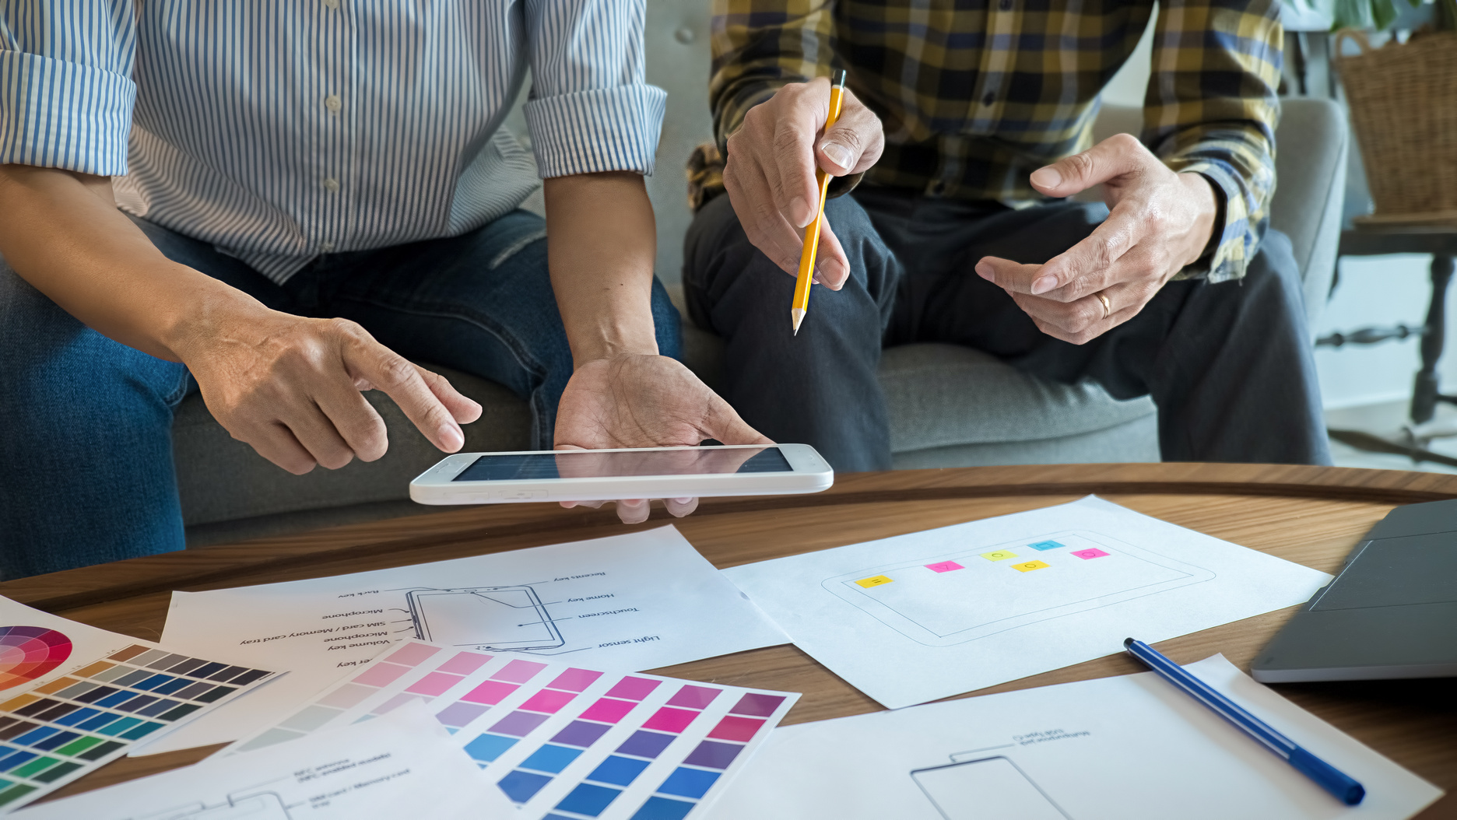

Ready to Work Together?
I’m thrilled about the chance to collaborate on exciting design projects that help brands stand out and communicate effectively. If you’re interested in working together or discussing opportunities, don’t hesitate to reach out!
Thank you for taking the time to review my portfolio. I look forward to bringing your creative visions to life!

Slide 11
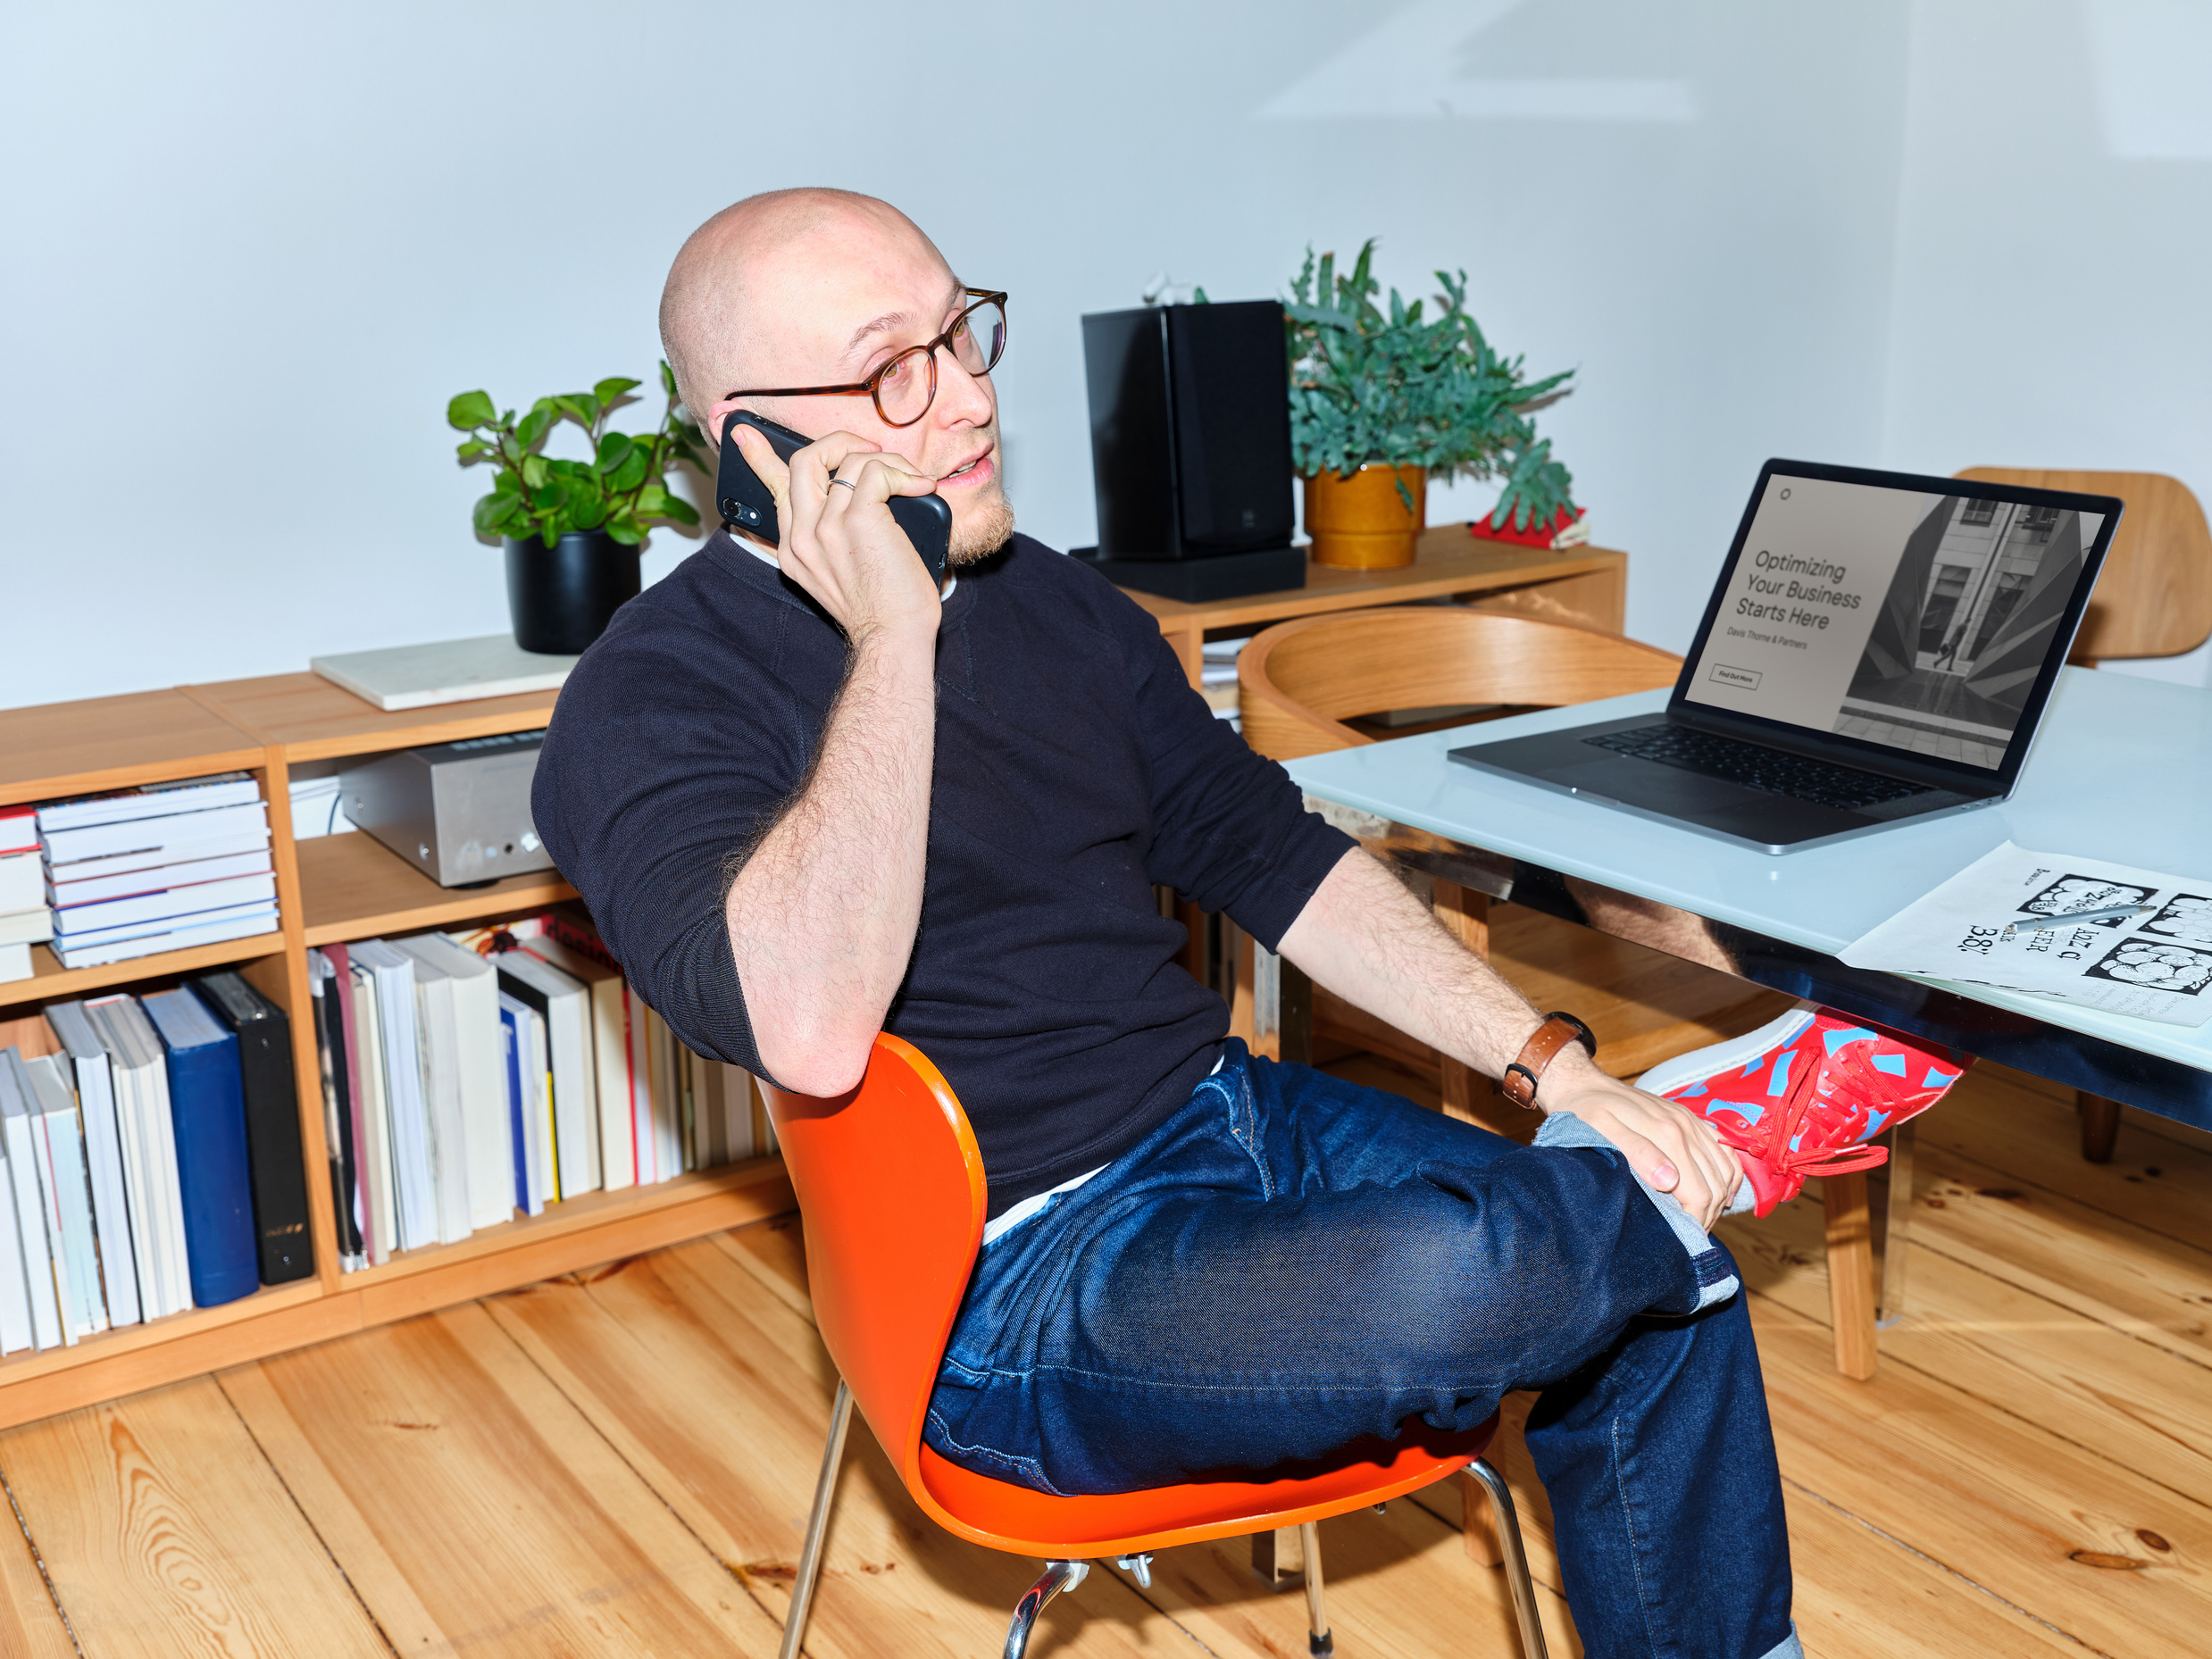



Contact Me
Estelle Darcy
+123-456-7890
123 Anywhere St., Any City
@reallygreatsite

